Slide 1
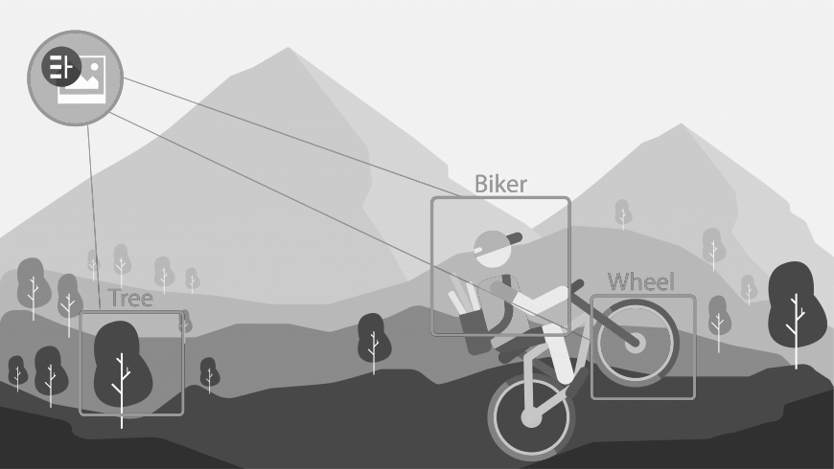
IBM Watson Visual Recognition API by Isaac Ramírez Herrera

Slide 2
What is it about?
The IBM Watson™ Visual Recognition service uses deep learning algorithms to analyze images for scenes, objects, faces, and other content. The response includes keywords that provide information about the content.

Slide 3
How to use it

Slide 4
Use cases
The Visual Recognition service can be used for diverse applications and industries, such as:
Manufacturing: Use images from a manufacturing setting to make sure products are being positioned correctly on an assembly line
Visual auditing: Look for visual compliance or deterioration in a fleet of trucks, planes, or windmills out in the field, train custom models to understand what defects look like
Insurance: Rapidly process claims by using images to classify claims into different categories
Social listening: Use images from your product line or your logo to track buzz about your company on social media
Social commerce: Use an image of a plated dish to find out which restaurant serves it and find reviews, use a travel photo to find vacation suggestions based on similar experiences
Retail: Take a photo of a favorite outfit to find stores with those clothes in stock or on sale, use a travel image to find retail suggestions in that area
Education: Create image-based applications to educate about taxonomies

Slide 5
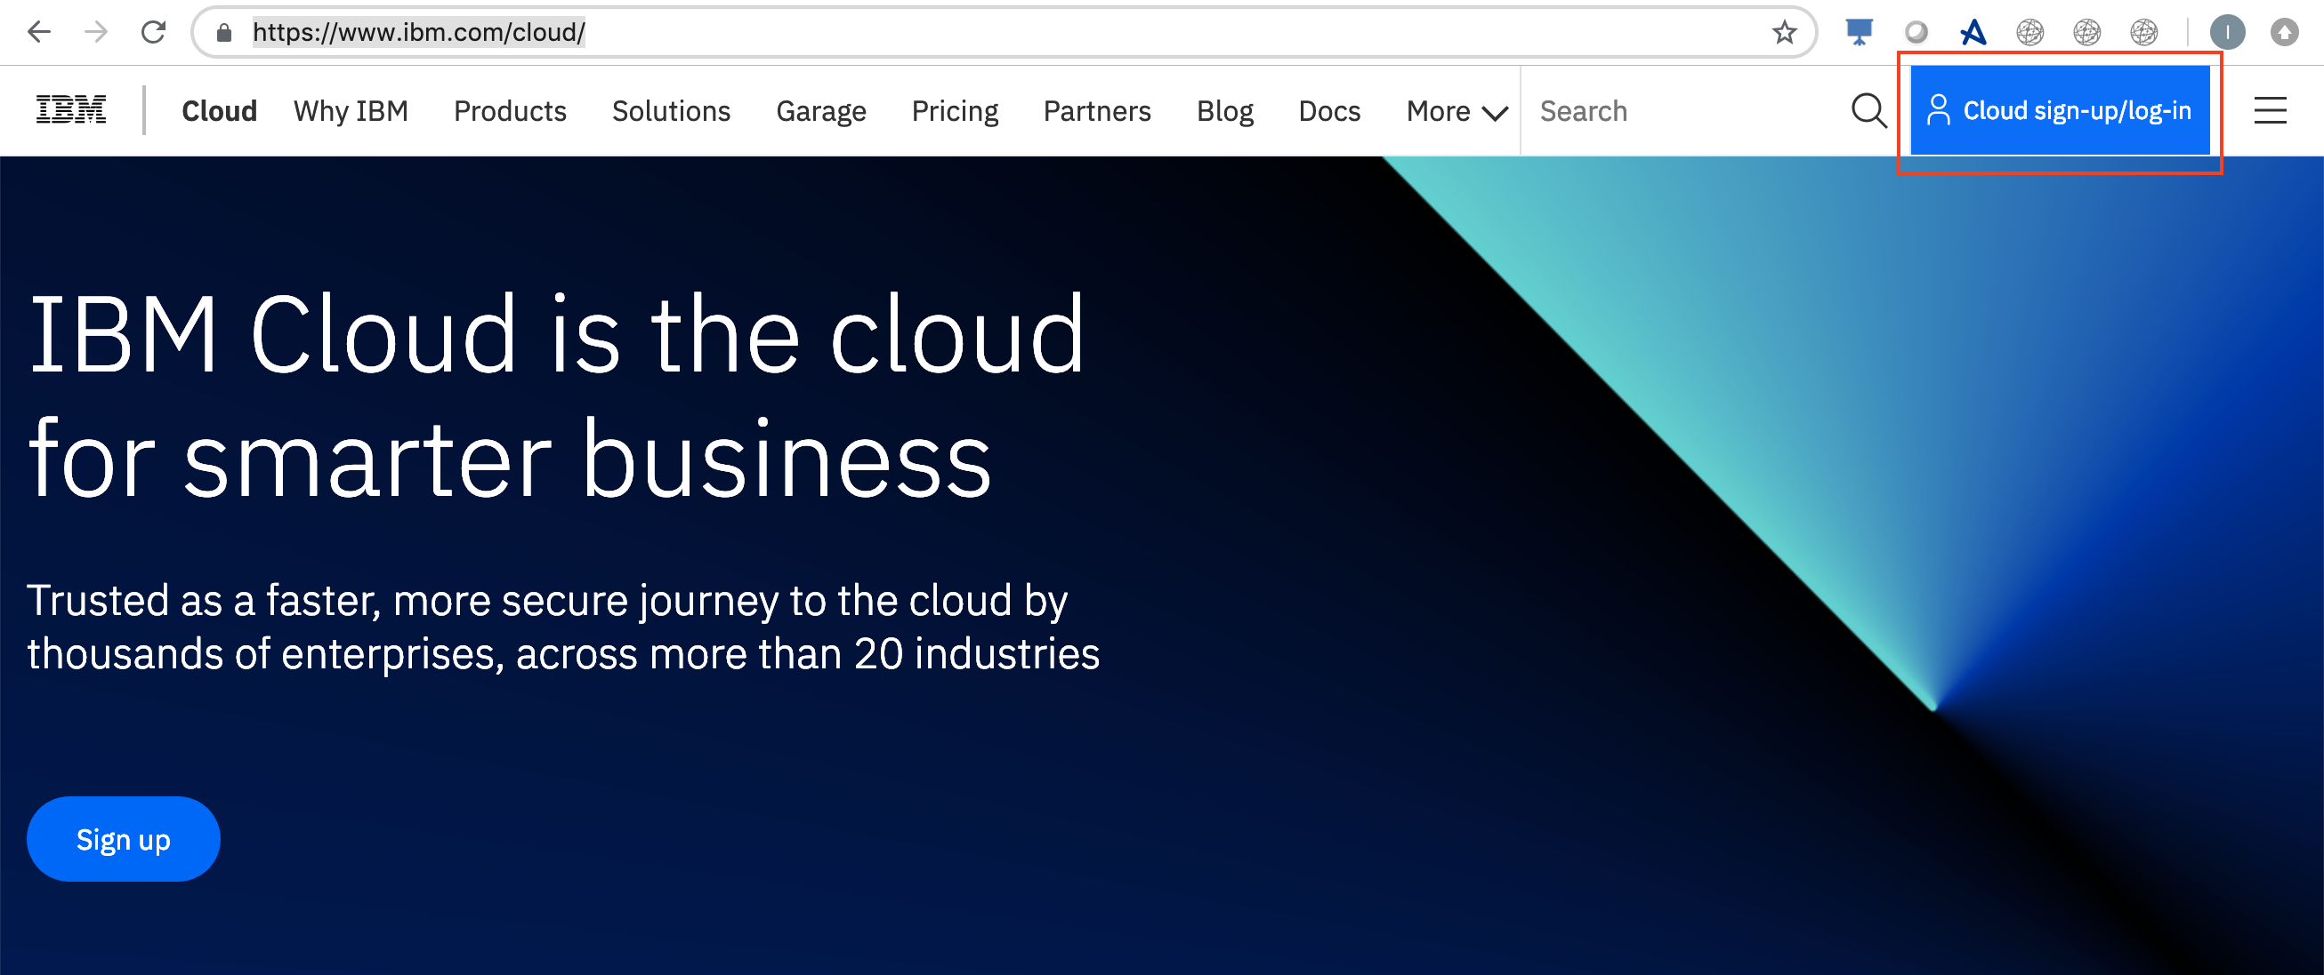
Let’s create an account
Go to https://www.ibm.com/cloud/

Slide 6
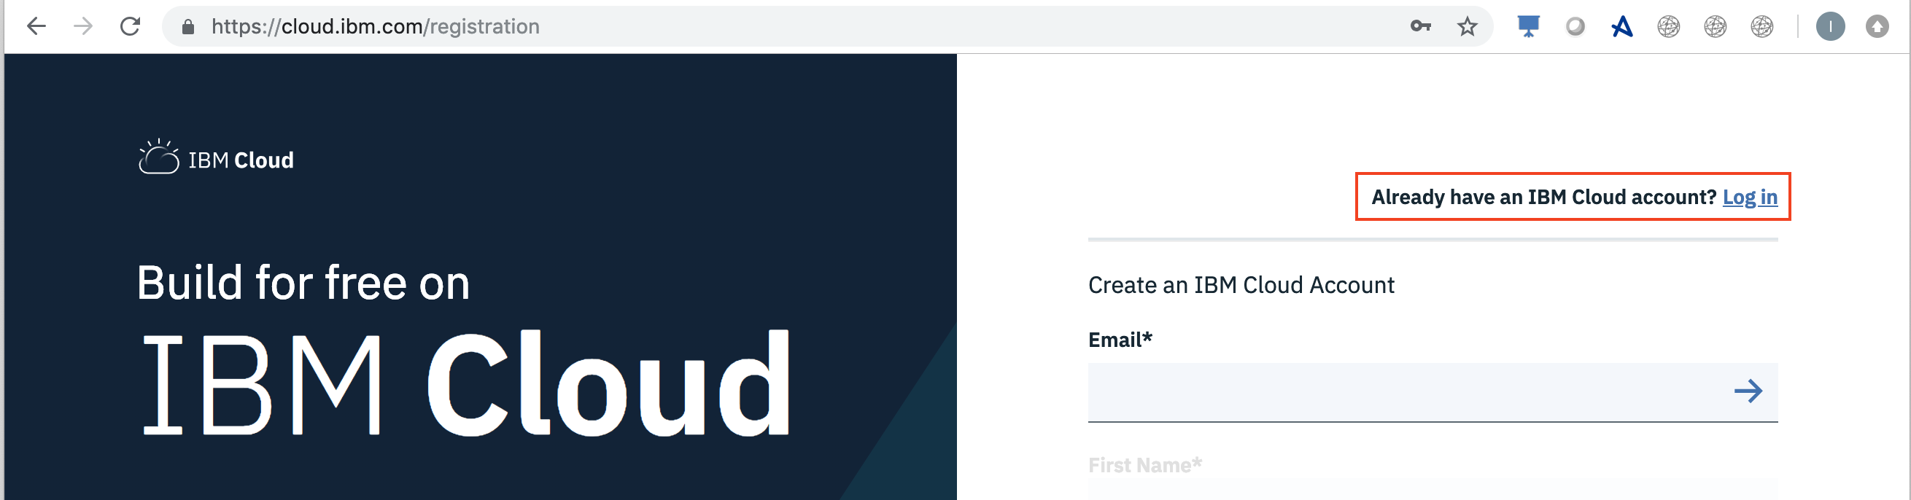
Let’s create an account
Login if you are already registered

Slide 7
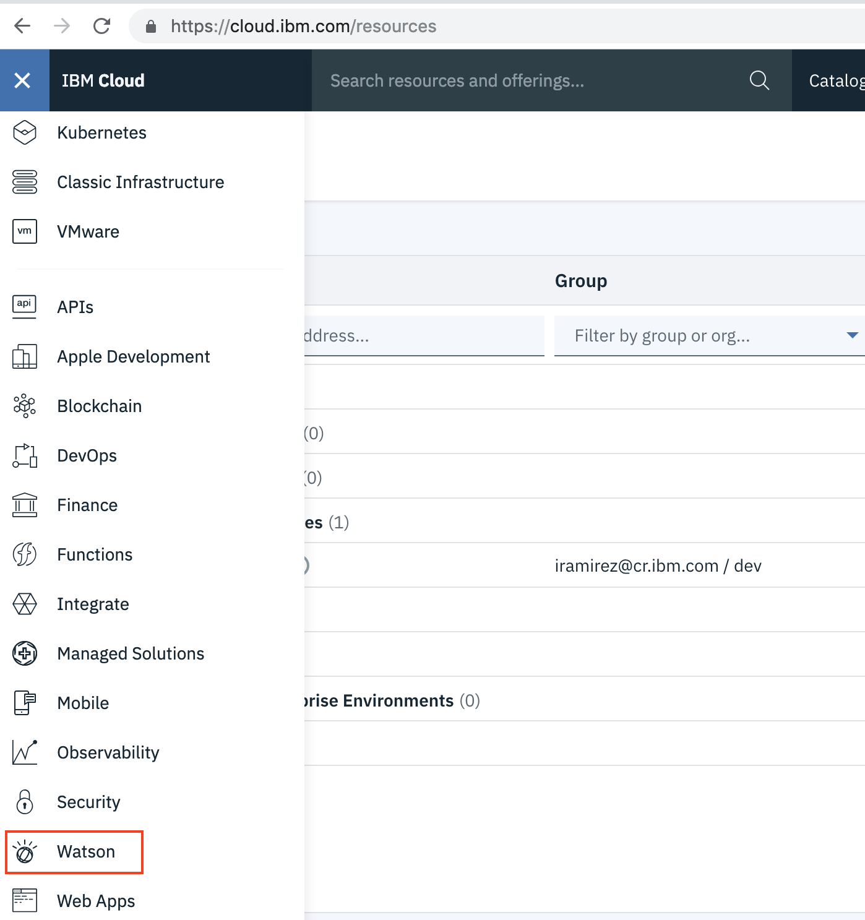
Now, create the service

Slide 8
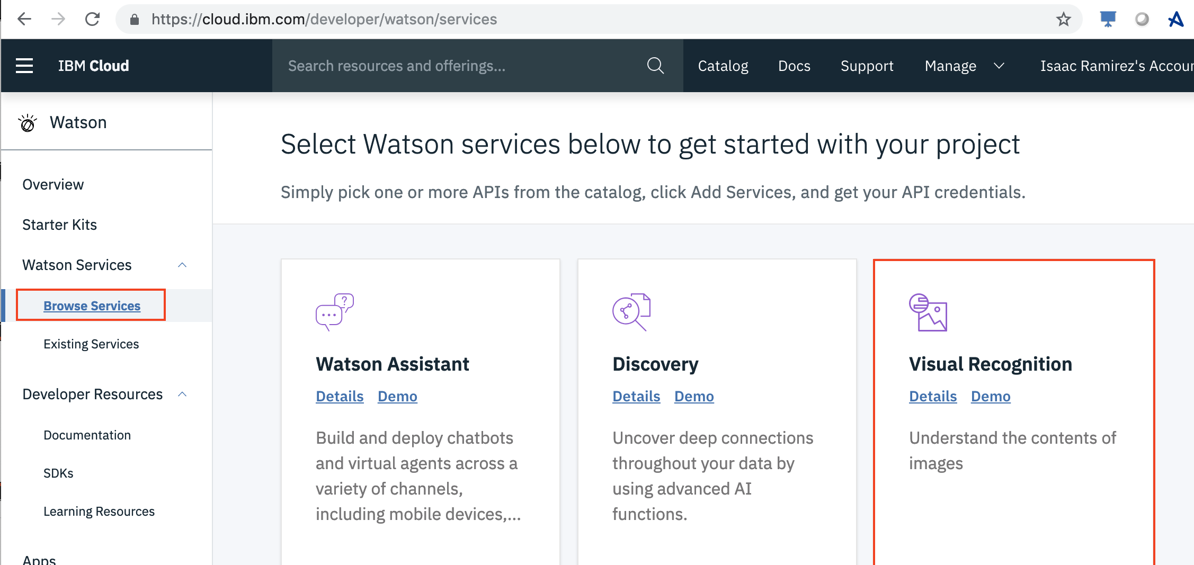
Now, create the service

Slide 9
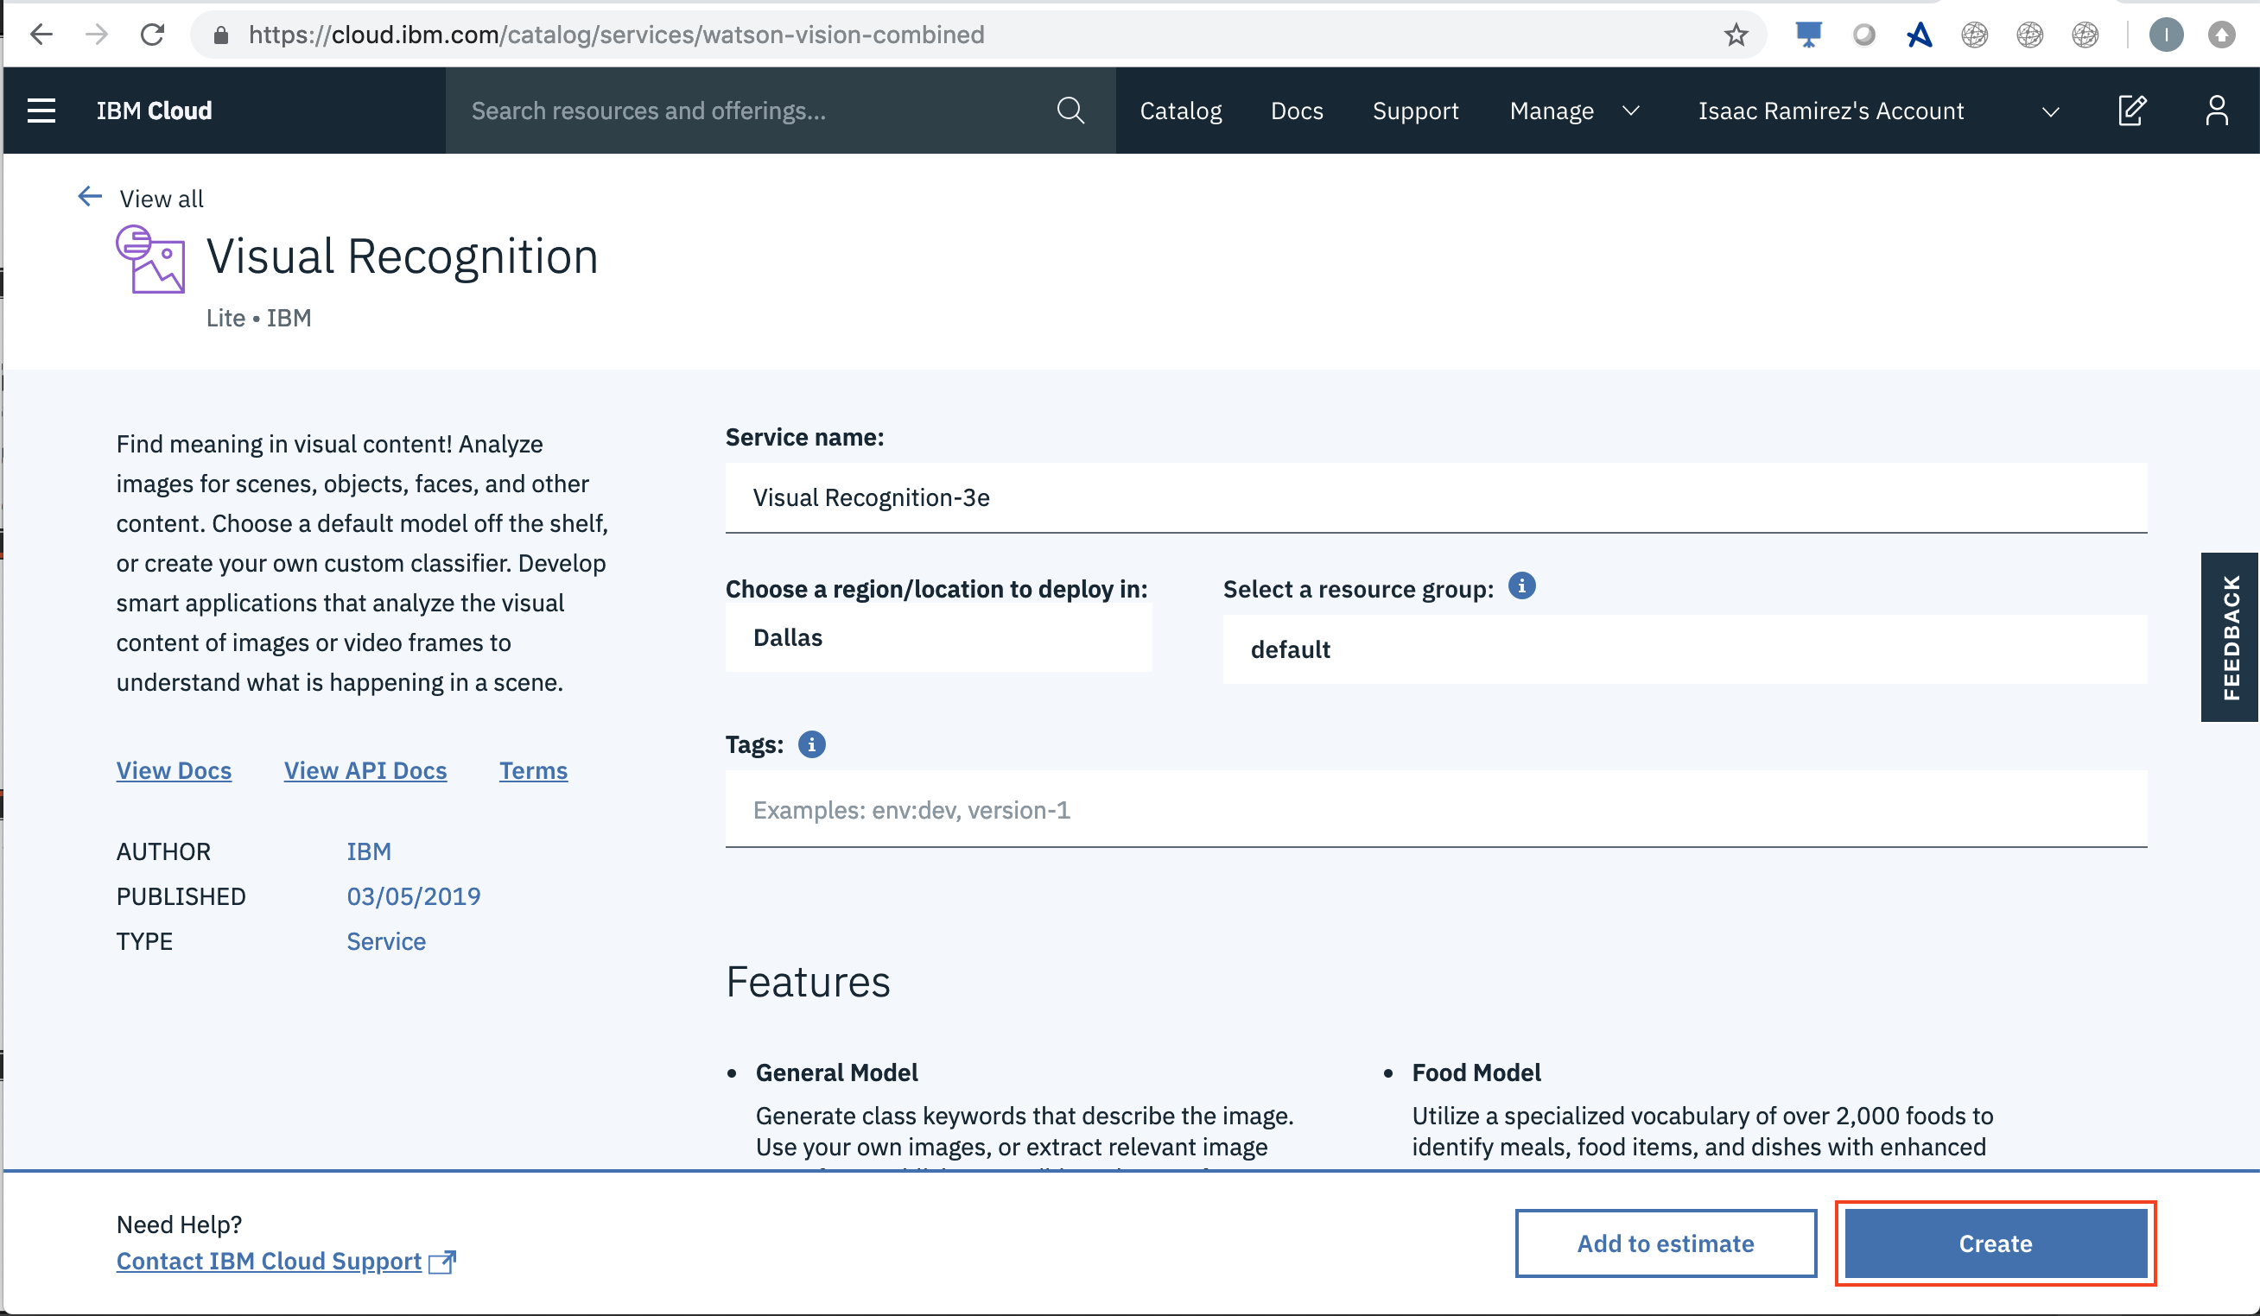
Now, create the service

Slide 10
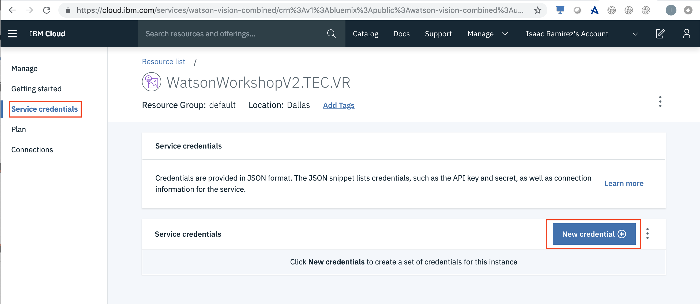
Retrieve the credentials

Slide 11
Retrieve the credentials

Slide 12
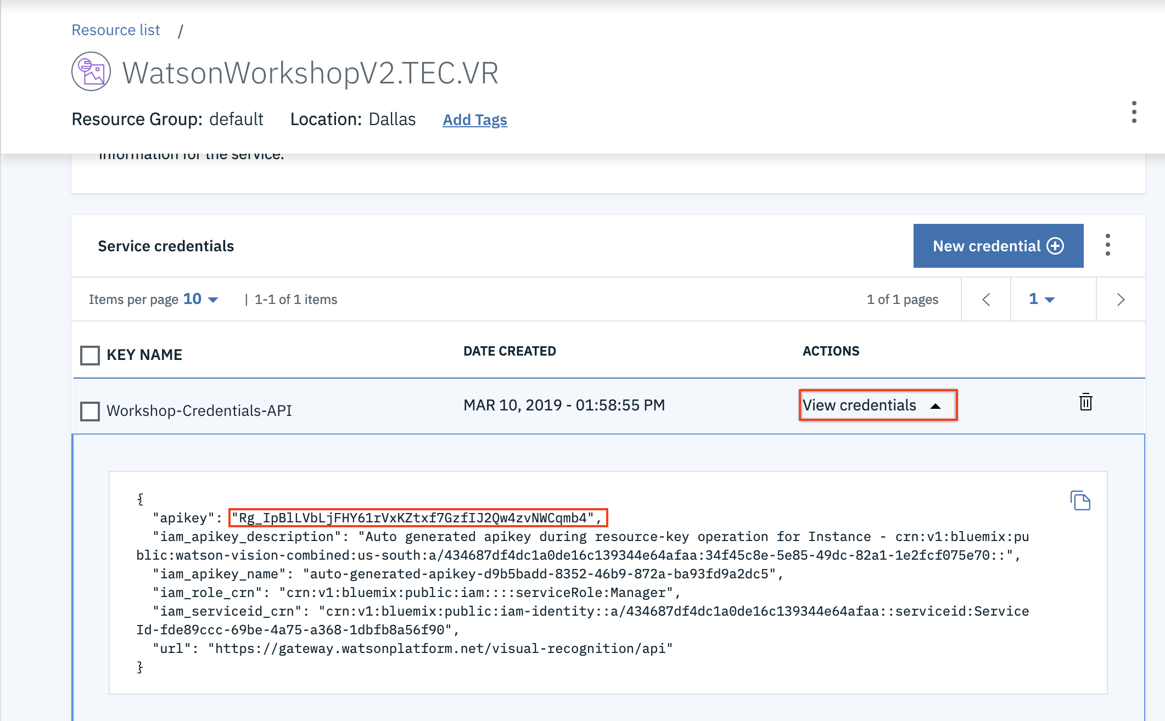
Retrieve the credentials

Slide 13
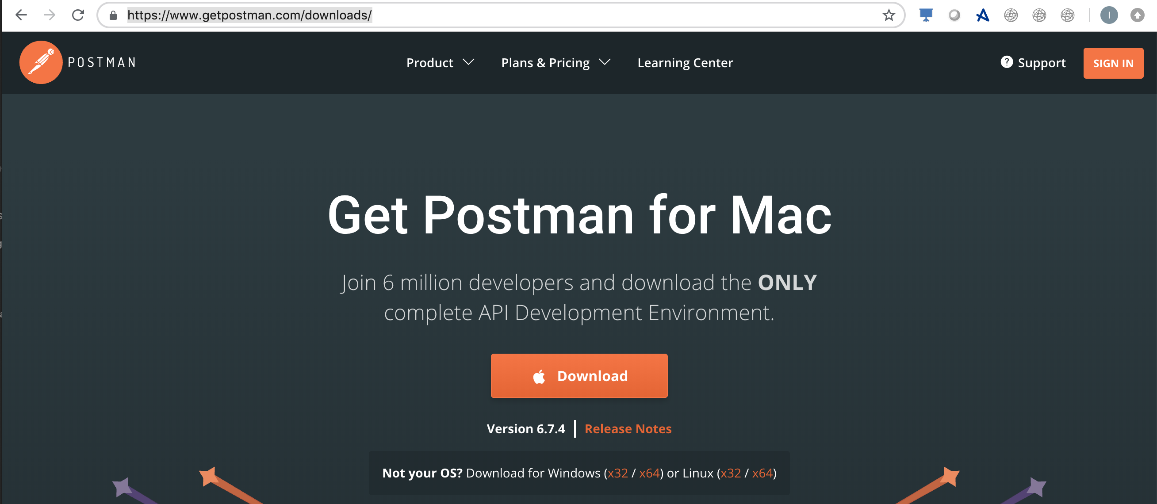
Test it with Postman
Download it from https://www.getpostman.com/downloads/

Slide 14
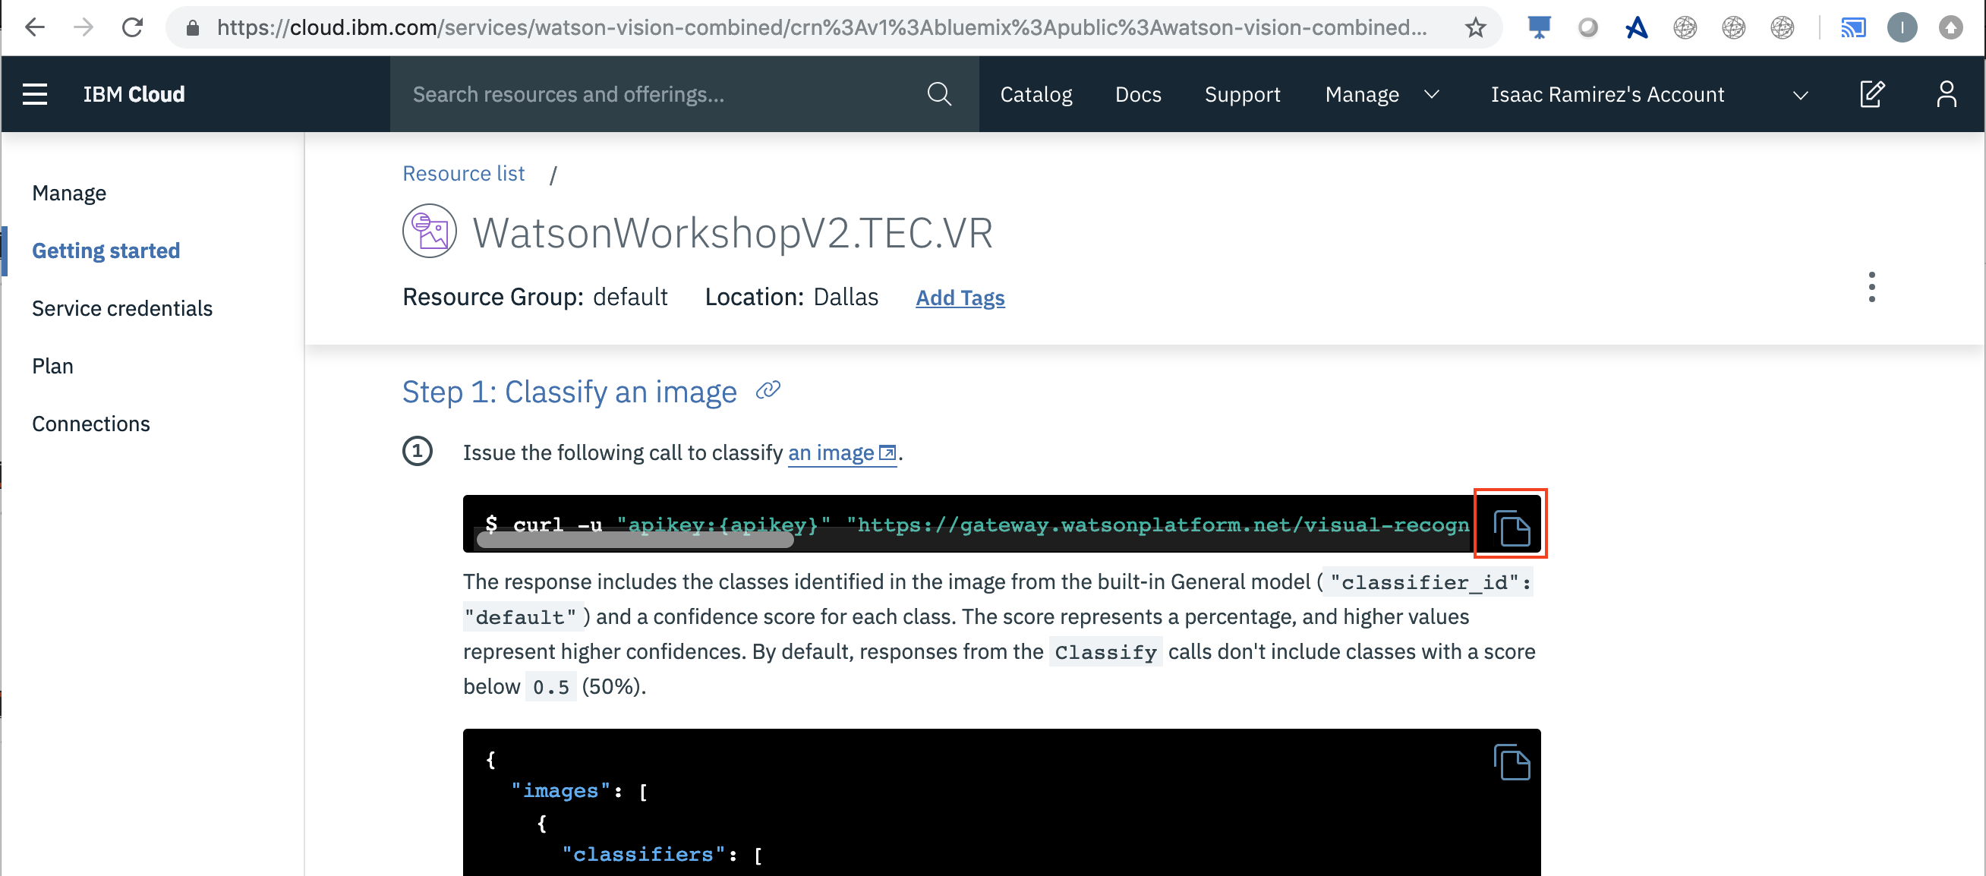
Test it with Postman

Slide 15
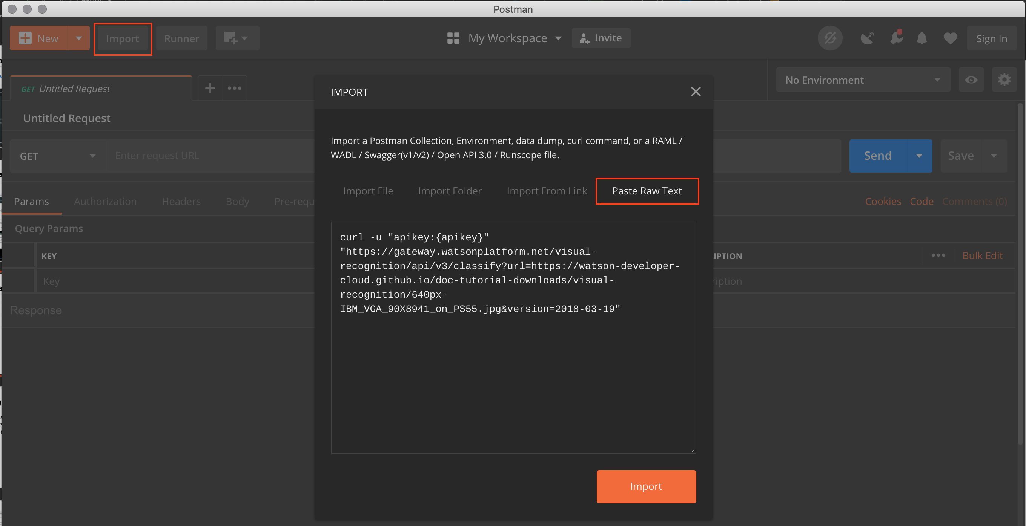
Test it with Postman

Slide 16
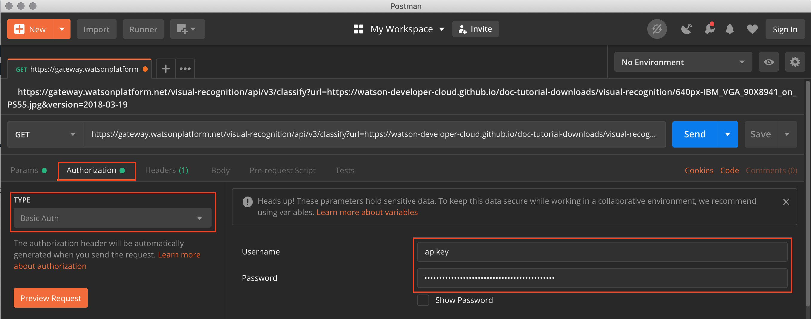
Test it with Postman

Slide 17
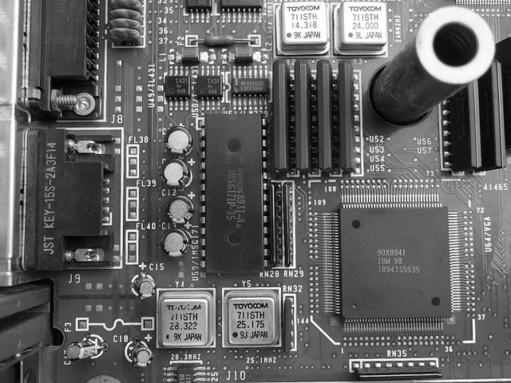
What did we just do?
{
"images": [
{
"classifiers": [
{
"classifier_id": "default",
"name": "default",
"classes": [
{
"class": "circuit board",
"score": 0.578,
"type_hierarchy": "/electrical device/computer circuit/circuit board"
},
{
"class": "computer circuit",
"score": 0.755
},
{
"class": "electrical device",
"score": 0.757
},
{
"class": "disk controller",
"score": 0.553,
"type_hierarchy": "/controller/disk controller"
},
https://watson-developer-cloud.github.io/doc-tutorial-downloads/visual-recognition/640px-IBM_VGA_90X8941_on_PS55.jpg

Slide 18
What next?
Let´s do the same in Java
Create an Swing application that let’s user select an image
Call the API to classify it
Then,
Learn how to create classifiers using Postman
Do the same in Java
Classify an image on the created classifier

Slide 19
Using the service in Java
Go to Eclipse and create a new Java project
Create a new lib folder to store the dependencies

Slide 20
Using the service in Java
Create a Java project
Download the Watson SDK and all its dependencies:
https://github.com/watson-developer-cloud/java-sdk/releases/download/java-sdk-6.14.0/java-sdk-6.14.0-jar-with-dependencies.jar
Add the jar to the project classpath

Slide 21
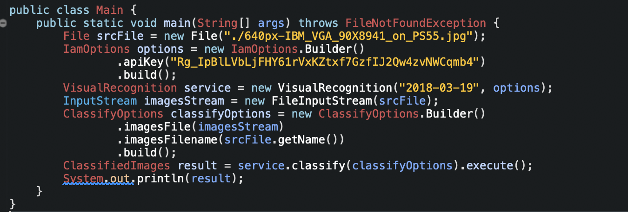
Using the service in Java

Slide 22
We are ready to code!

